Slide 1
Fake News Detection
Presented by:
Jainisha Choksi

Slide 2
Introduction
Fake News or hoax news is false or misleading information presented as news.
Fake news often has the aim of damaging the reputation of a person or entity, or making money through advertising revenue.
It is the problem of Text Classification as Fake and Real News.

Slide 3
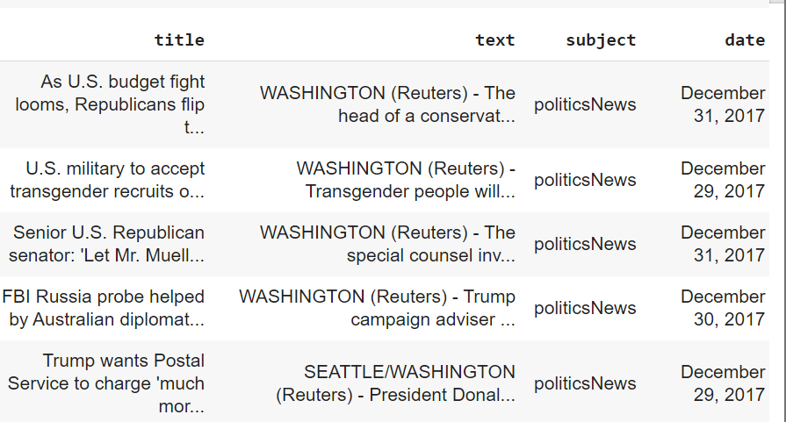
Dataset: True

Slide 4
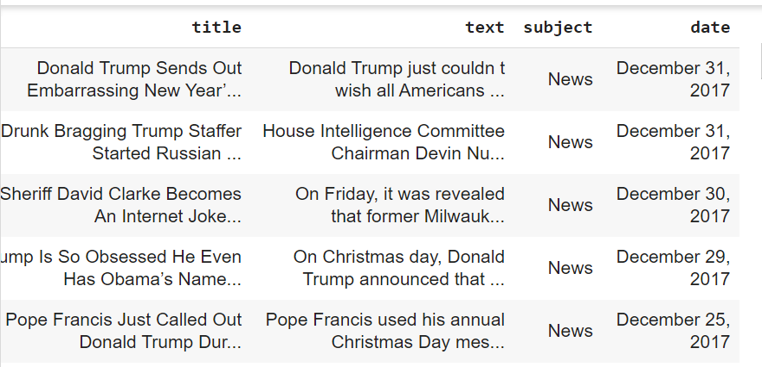
Dataset: False

Slide 5
Dataset
Here, we have 2 datasets as: True and False.
True has 21417 rows
False has 23481 rows
Class Imbalance problem - we create a new dataframe by merging both the datasets into 1 by taking 5000 rows from each by adding label column for the classification.

Slide 6
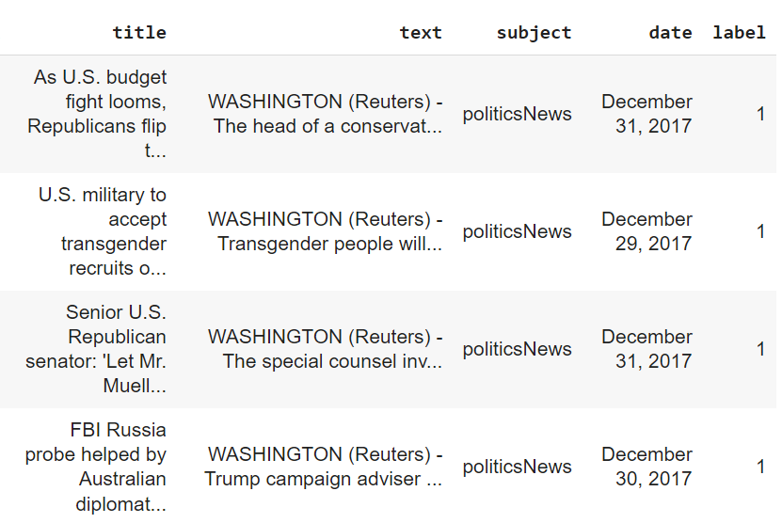
Dataset

Slide 7
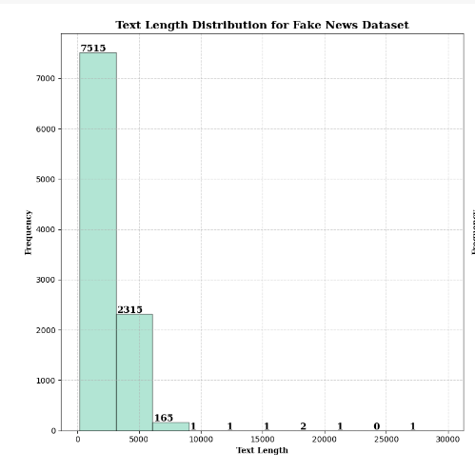
Exploratory Data Analysis

Slide 8
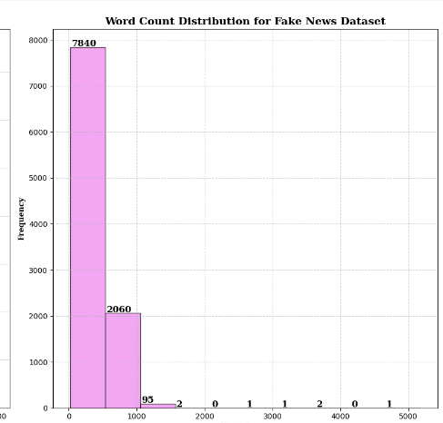
Exploratory Data Analysis

Slide 9
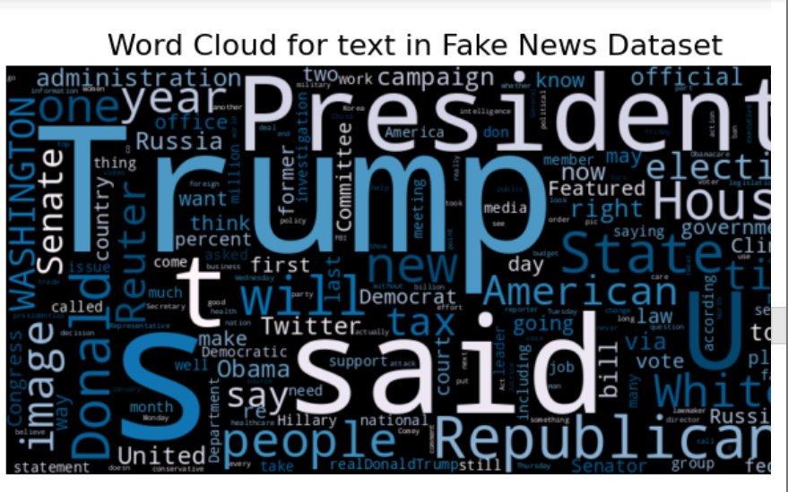
Exploratory Data Analysis

Slide 10
Data Preprocessing
Natural Language Preprocessing is used.
Convert to Lowercase
Splitting the words
Removing Stopwords
Performing Stemming
Join words as text

Slide 11
TF-IDF Vectorizer
TF-IDF Term Frequency Inverse Document Frequency
Increases proportionally to the number of times in the text a word appears but is compensated by the word frequency in the corpus.
Term Frequency:In document d, the frequency represents the number of instances of a given word t. The weight of a term that occurs in a document is simply proportional to the term frequency.
tf(t,d) = count of t in d/ number of words in d

Slide 12
Document Frequency
Similar to TF but in whole corpus collection.
df(t) = occurrence of t in documents
Inverse Document Frequency: IDF of the word is the number of documents in the corpus separated by the frequency of the text.
idf(t) = N/ df(t)
tf-idf(t,d) = tf(t,d) * idf(t)

Slide 13
Machine Learning Models
Passive Aggressive Classifier:
Passive: If the prediction is correct, keep the model and do not make any changes i.e. the data in the example is not enough to cause any changes in the model.
Aggressive: If the prediction is incorrect, make changes to the modeli.e. Some change to the model may correct it.
Accuracy = 0.998

Slide 14
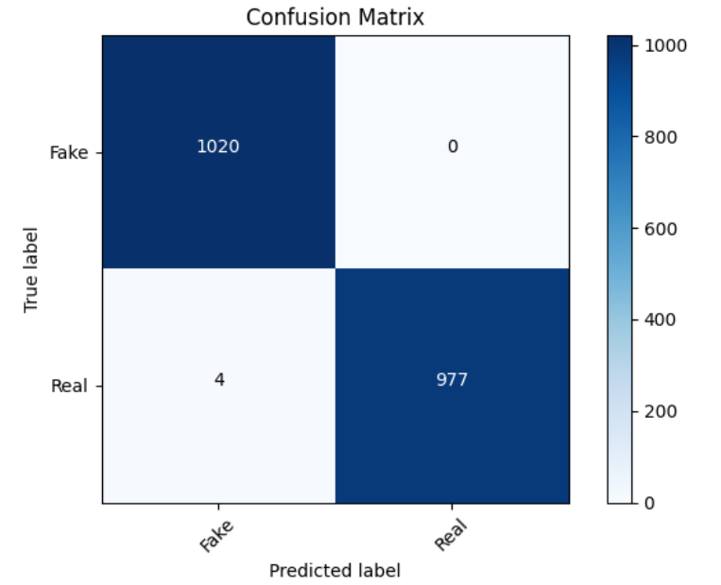
Confusion Matrix

Slide 15
Conclusion
Detecting and addressing fake news demands a holistic approach. By leveraging tech tools, promoting media literacy, and fostering partnerships, we can build a robust defense against misinformation.

Slide 16
Future Scope
Use of Advance Machine Learning Algorithm
Natural Language Processing Enhancements
Cross-platform Collaboration
Ethical AI Practices
Online Machine Learning
Public Awareness Campaigns

Slide 17
Thank You

